Slide 1
M.P State Agricultural Marketing Board
& NIC M.P State Centre
Integrated eMANDI
And eANUGYA
1

Slide 2
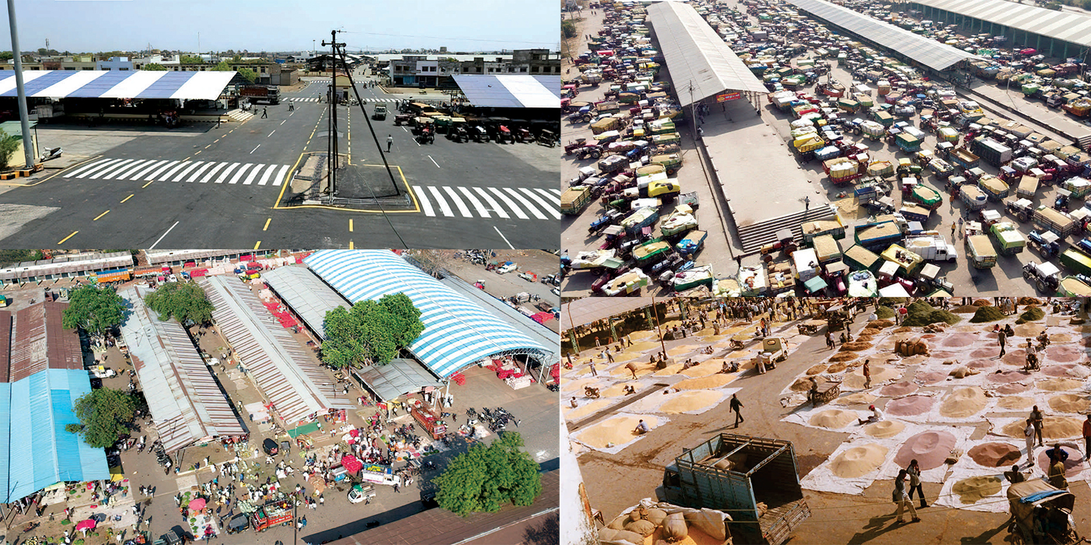
Madhya Pradesh State Agriculture Marketing Board (MPSAMB)
In accordance with the recommendations of the National Agriculture Commission, the M.P. State Agricultural Marketing Board i.e. MPSAMB (also known as Mandi Board) has come into existence w.e.f 1973 under the provisions of M.P. Krishi Upaj Mandi Adhiniyam 1972.
259
298
3983
Agriculture Produce Marketing Committee
APMC - Sub Market
Agriculture Produce Arrival
(Lacs Metric ton)
(from 2014 to 2023)
2

Slide 3
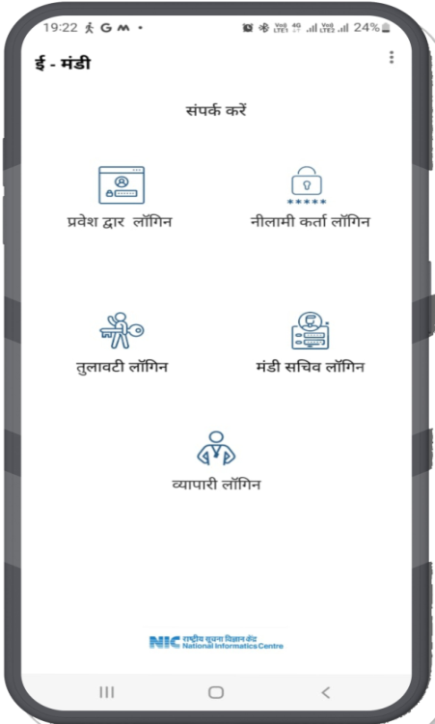
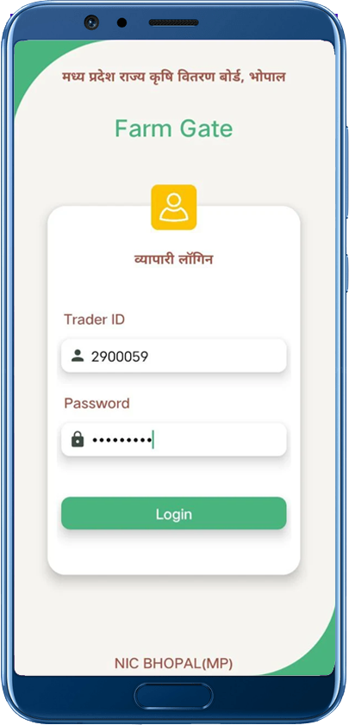
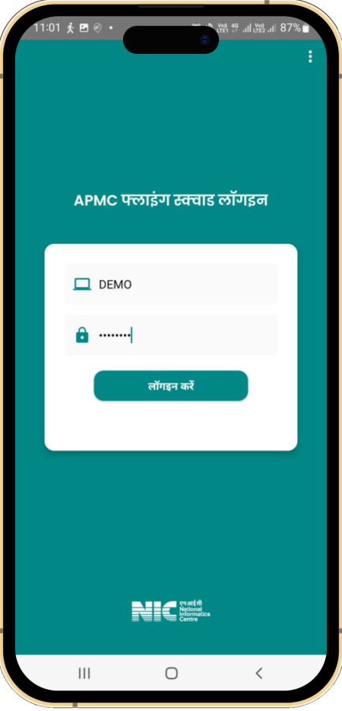
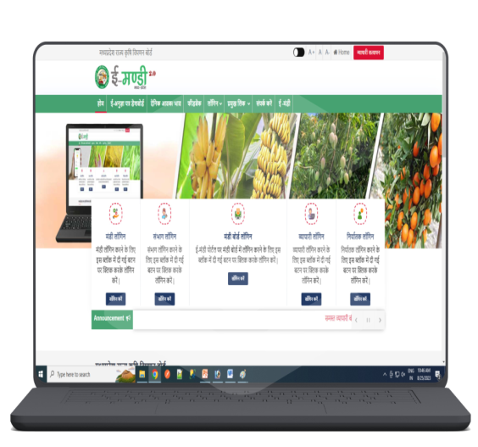
INTEGRATED Digital Solution - eMANDI
e-MANDI App
M.P Farm Gate App
e-Anygya Application
Flying Squad App
Within APMC Yard- From Gate Entry to Weighment Bridge.
Random Inspection on the way and at Godown by team of APMC
Outside AMPC Yard-Farmer’s Doorstep Services
Generating e-Anugya (NOC) Process
3

Slide 4
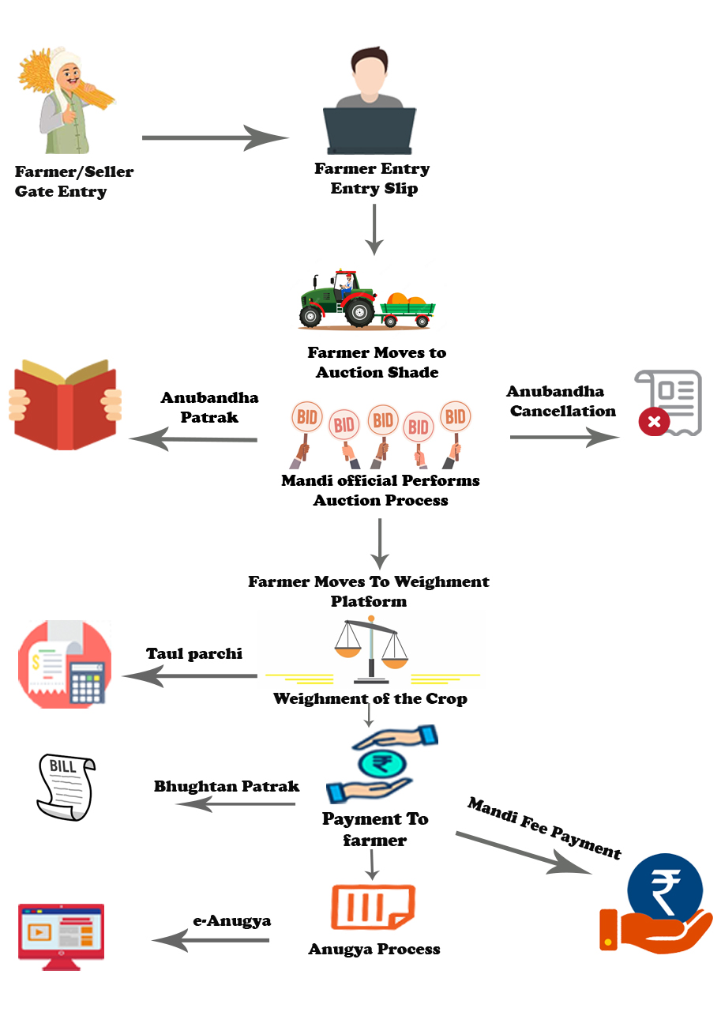
eMANDI Android App (Within APMC Yard Process)
Gate Pass
Process
Farmer/Seller details and crop details including tentative weight
Input
Output
Gate Entry Slip
Process
The Winner Bidder is captured and Anubandha Patrak generated
Auction
Input
Output
Anubandha Patrak
Taul Process
Process
Final Weight is captured
Input
Output
Taul Parchi
Taul Parchi Integrated with eANUGYA application for Auto generation of Bhughtan Patrak i.e. payment to farmer. Then Submit APMC Fee and finally issue e-Anugya (NOC) by APMC or Trader also.
4

Slide 5
e-Anygya - Application
Ease of Doing Business
Stock and Fee Monitoring
Live Data Management
Paperless & Transparent Tool
https://eanugya.mp.gov.in
5

Slide 6
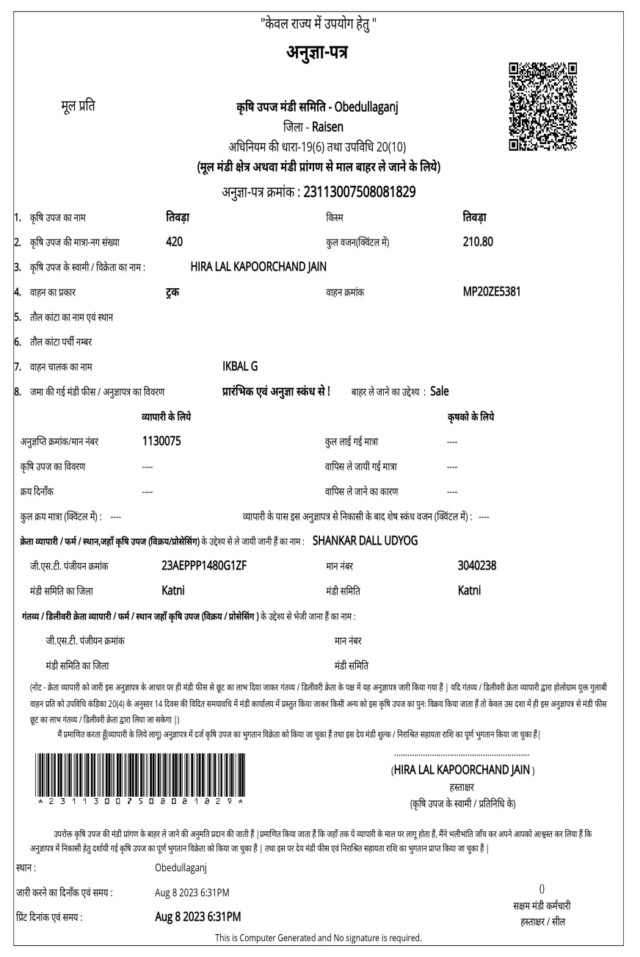
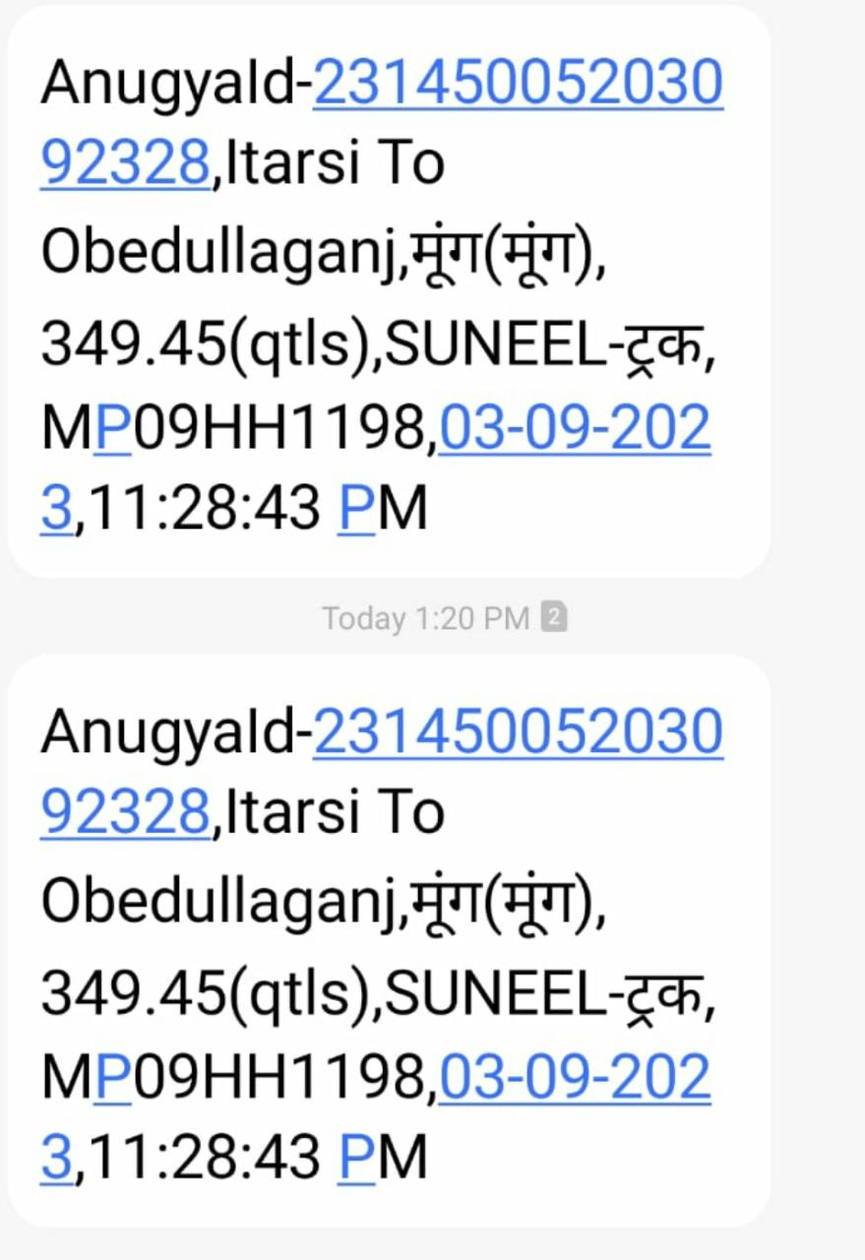
e-ANUGYA
1
Legal Document to transfer commodities
2
Authentic document for APMC Fee
3
Live tracking of Stocks and Inventory
4
Bulk operating mechanism for Government Entities
6

Slide 7
ANUGYA PROCESS-AS IS (MANUAL PROCESS)
Dispatch declaration (Form-10) Submitted by Trader/Seller
Trader Stock & APMC-Fee calculation
Entry of Receipt, Amount and Anugya patrak number
Issue of Anugya patrak (Form-9) by APMC officials
Submit to Destination APMC by Trader/Buyer
Destination APMC send Anugya patrak to the Origin APMC for Verification
7

Slide 8
ANUGYA PROCESS-Revamped
Single Entry /Bulk Entry of Bhugtan patrak through Excel Sheet (APMC Purchase)
Entry of the Crop Purchased Outside State
Entry of Anugya patrak Purchase from Trader(RO/DO)
Calculation of APMC and Nirashrit Fee
Stock Inventory & APMC Fee Updated in the Traders & APMC Account
Dispatch Declaration (Form-10) Entry by Seller
Generation of eAnugya (Form-9) by Seller
Intimation sent to APMC by the Buyer
Verification by the Destination APMC
8

Slide 9
Services & Features
E-Mandi Android App is used for Gate Entry, Auction and Weighment only.
Tracks Quantity & Live Rates.
Monitor Price variation of all the commodities.
Fast payment to farmers & APMC Fee.
Records Traders Payment methods (Cash/Digital).
Online verification of Bhugtan Patrak.
Online generation of Anugya Patrak (NOC).
Automated Stock register.
Ease of Inter State trade.
Trader to Trader business platform.
9

Slide 10
Transformation of Processes and Benefits
Before Transformation | After Transformation
OFFLINE | ONLINE
Anugya(NOC) can only be issued by APMC | Now Trader can also issue it ONLINE
Anugya(NOC) can be issued 10 AM to 12 PM on all working days | Trader can issue it on 24x7 basis
Overload on APMC staff | Workload reduced to a great extent
Under section 20-21 of APMC act, verification of accounts was very slow and tedious | Verification available through system has reduced time.
Fortnight Report by trader was submitted manually | Now it is available on Portal itself
Modal, Minimum and Maximum Prices calculation was not accurate | Available through system.It is also in public domain.
Strategic planning was difficult due to lack of data | Various reports are available for data analysis and decision making
10

Slide 11
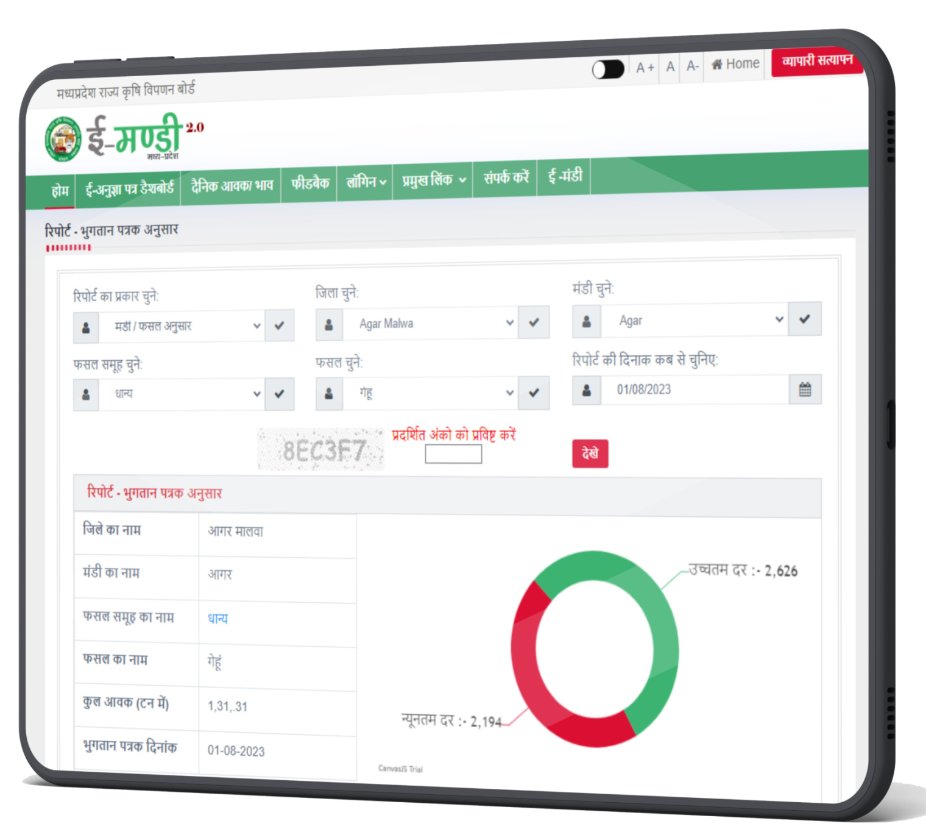
Impact
No need to visit APMC
APMC work load reduction
Human Resources cost reduction
Arrival increased
APMC Fee evasion reduced
APMC Fee collection increased
Stationery cost reduced
11

Slide 12
E-Anugya and Bhugtan Patrak
1,687
No of Anugya Patrak Issued today
56,918
No of Anugya Patrak Issued during the month
7279113 (73 lacs)
No of Anugya Patrak Issued since 16-08-2019
62,326
Total No of licensed Traders
39,400
Active licensed Traders
50269493 (5 cr)
No of Bhutan Patrak since inception
APMC Fee
Amount(cr)
4,235.45 Total APMC Fee
503.14 Nirashrit Fee
Source : e-Anugya portal (as on 15/09/2023)
12

Slide 13
E-Anugya and Bhugtan Patrak
Source : e-Anugya portal (as on 15/09/2023)
13

Slide 14
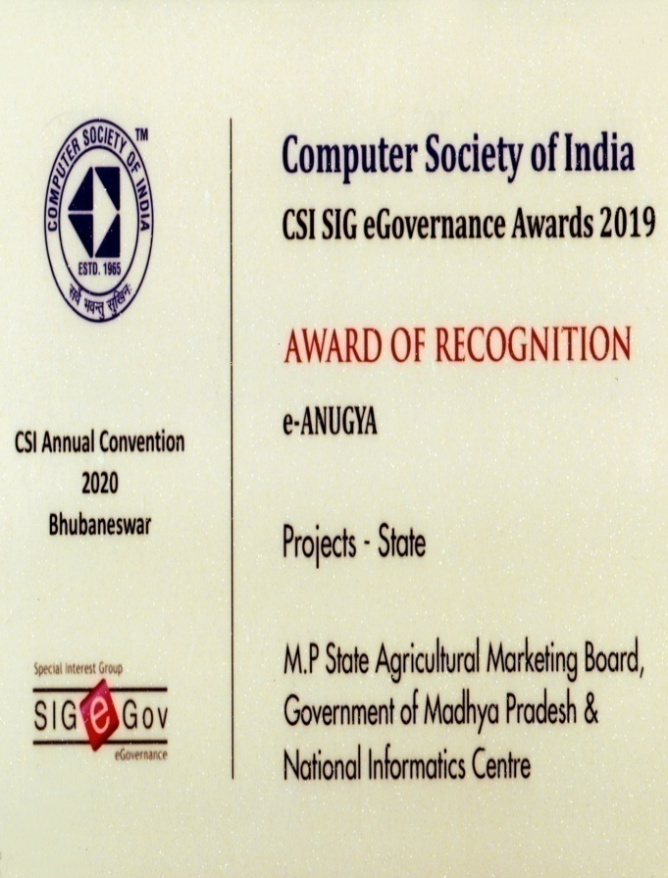
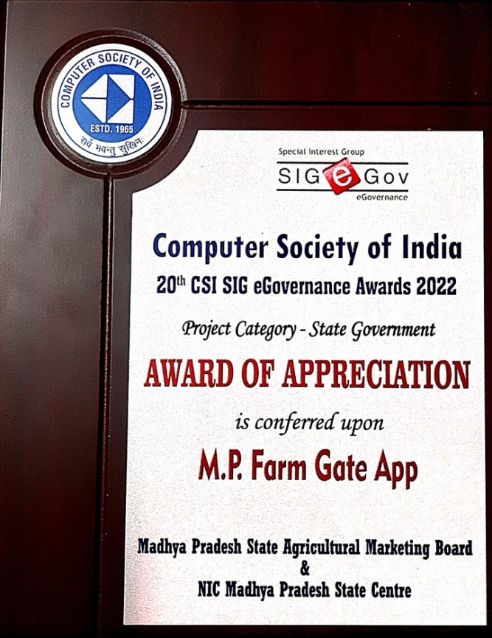
Awards & Accolades
CSI SIG e-Governance Award of Recognition 2019 for the Project e-ANUGYA
SKOCH Silver Award 2020 for the Project eMANDI and eANUGYA
CSI SIG e-Governance Award of Appreciation 2022 for M.P Farm Gate App
14

Slide 15
THANK YOU!
Shriman Shukla, IAS
Commissioner cum Managing Director,
Madhya Pradesh State Agricultural Marketing Board (MPSAMB), BHOPAL (M.P.)
15

